Slide 1
Chapter 5:
Spectral Analysis of Random Signals

Slide 2
References
[1] Proakis and Manolakis, Digital Signal Processing, 3rd Ed. (1996), 4th Ed. (2006), Prentice-Hall.
[2] Steven M. Kay, Fundamentals of Statistical Signal Processing: Estimation Theory, Prentice Hall, 1993.
[3] Dimitris G. Manolakis, Vinay K. Ingle, Stephen M. Kogon, Statistical and Adaptive Signal Processing, Artech House, 2005.

Slide 3
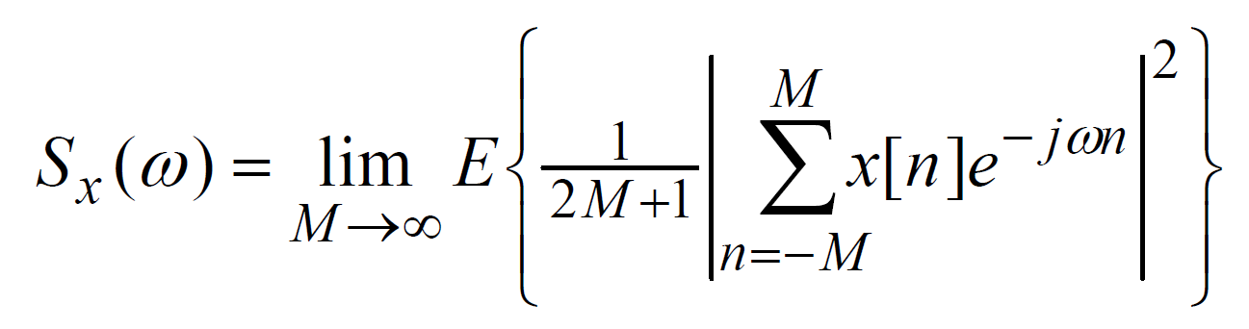
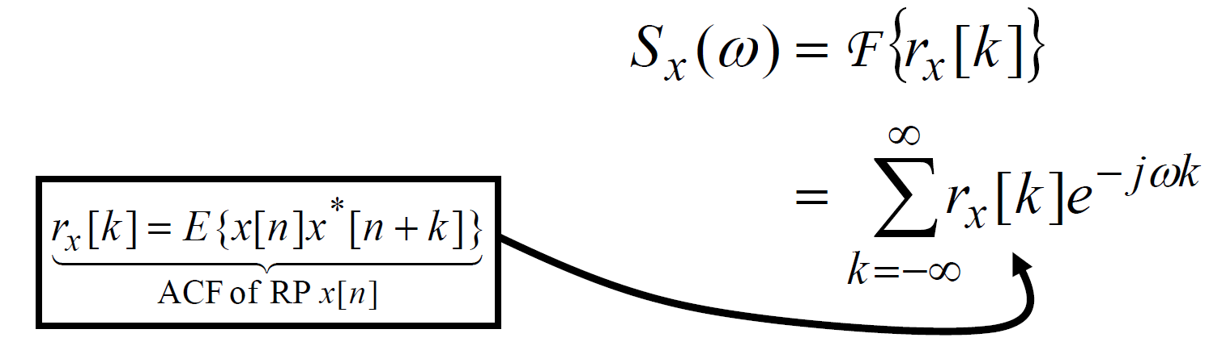
Introduction (1)
Definition of PSD (Power Spectral Density)
Given a WSS random process x[k] the PSD is defined by:
Recall the Wiener-Khinchine theorem:
(5.1)
(5.2)

Slide 4
Introduction (2)
Problem of PSD estimation:
Both (5.1) and (5.2) involve ensemble averaging but in practice we get only one realization from the ensemble.
Both (5.1) and (5.2) use a Fourier transform of infinite length but in practice we get only a finite number of samples.
(Note: a finite number of samples allows only a finite number of autocorrelation function - ACF values)
(5.1) & (5.2) motivate two approaches to PSD estimation:
1. Compute the DFT of the signal and then do some form of averaging.
2. Compute and estimate of the ACF using some form of averaging and then compute the DFT.
Both of them are called classical non-parametric approaches –they strive to do the best with the available data without making any assumptions other than that the underlying process is WSS.

Slide 5
Introduction (3)
Modern parametric approach:
There is a so-called modern approach to PSD estimation that tries to deal with the issue of having only a finite number of samples:
Assume a recursive model for the ACF.
Allows recursive extension of ACF using the known values.
Example model:
We’ll see that for this approach all we’ll need to do is estimate the model parameters {a_{i}} and then use them to get an estimate of the PSD. Thus, this approach is called parametric.

Slide 6
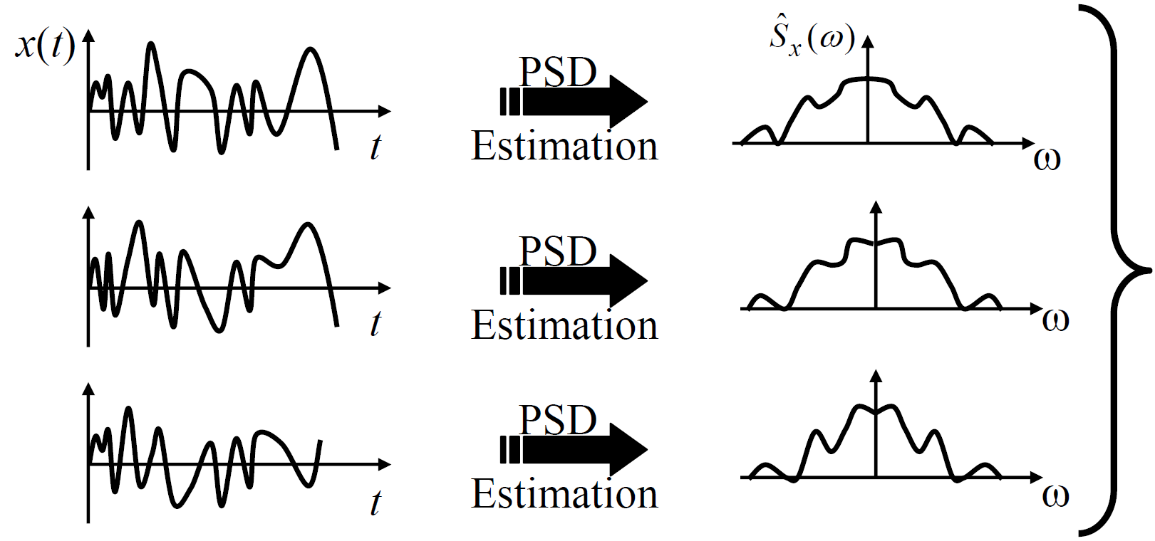
Introduction (4)
Review of statistics
What are we doing in PSD estimation?
Given: Finite number of samples from one realization.
Get: Something that “resembles” the PSD of the process.
Each PSD estimate is a realization of a random process.
Each signal
realization
gives a different
PSD estimate
realization

Slide 7
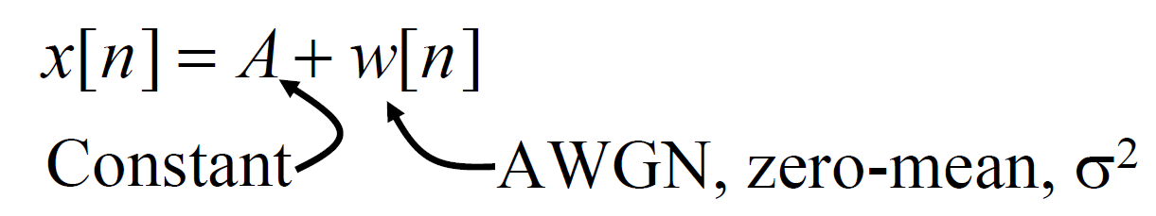
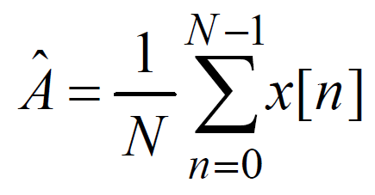
Introduction (5)
Thus, must view PSD estimate as a random process.
Need to characterize its mean and variance:
Want mean of PSD estimate = true PSD
Want variance of PSD estimate = small
To make things easier to discuss, we use a slightly different estimation problem to illustrate the ideas, consider the process:
Given a finite set of data samples x[0],…, x[N-1], estimate A.
Reasonable estimate (sample mean) is:
For each realization of x[n] we get a different value for the estimate of A.

Slide 8
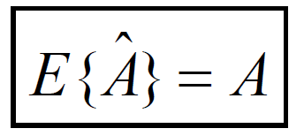
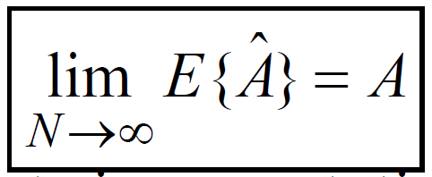
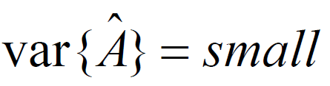
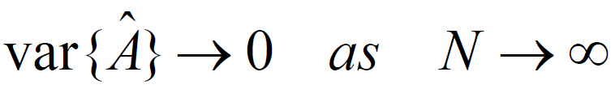
Introduction (6)
We want two things for the estimate:
1. We want our estimate to be “correct on average”:
If this is true, we say the estimate is unbiased.
If it is not true then we say the estimate is biased.
If it is not true, but
we say that the estimate is asymptotically unbiased.
2. We want small fluctuations from estimate to estimate:
Also, we’d like

Slide 9
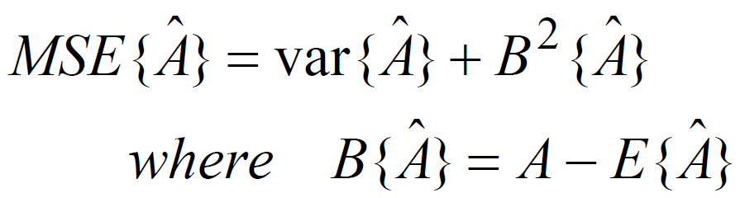
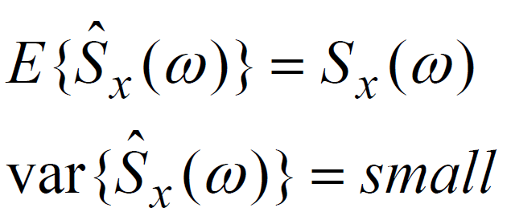
Introduction (7)
Can capture both mean and variance of an estimate by using Mean-Square-Error (MSE):
Usual goal of estimation: Minimize MSE
Minimize Bias
Minimize Variance.
For PSD Estimation want:

Slide 10
Non-Parametric Spectral Estimation
Periodogram
Windowed Periodogram
Averaged Periodogram
Windowed & Averaged Periodogram
Blackman-Tukey Method
Minimum Variance Method

Slide 11
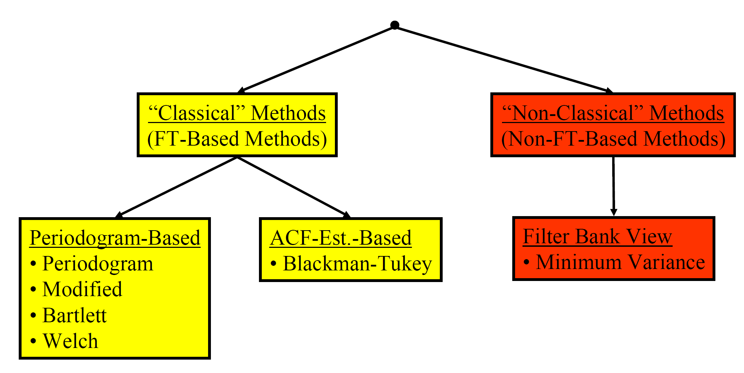
Family of Non-Parametric Methods

Slide 12
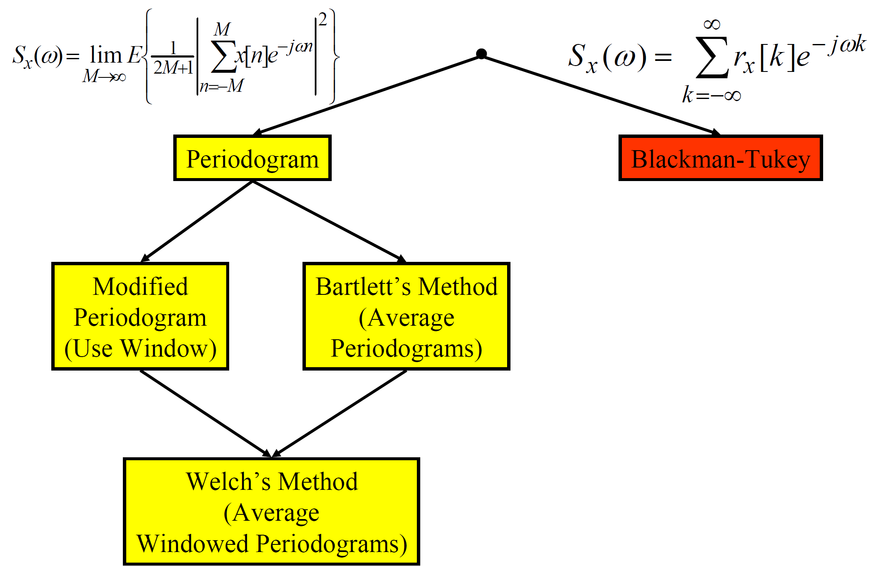
Family of Classical Methods

Slide 13
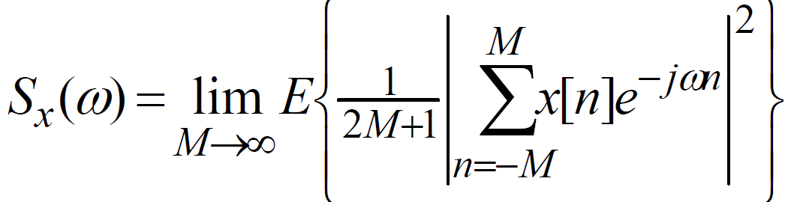
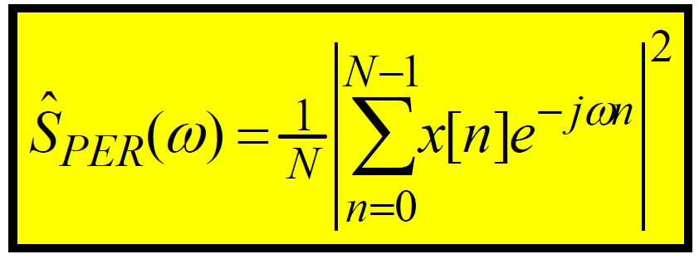
Periodogram (1)
Periodogram –Definition
Based on:
In practice, we have one set of finite-duration data. Two practical problems:
1. Can’t do the expected value
2. Can’t do the limit.
The periodogram is a method that ignores them both:
In practice, we compute this using the DFT (possibly using zero-padding) –which computes the DTFT at discrete frequency points (DFT bins).

Slide 14
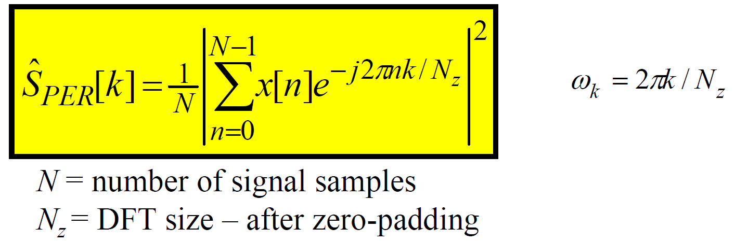
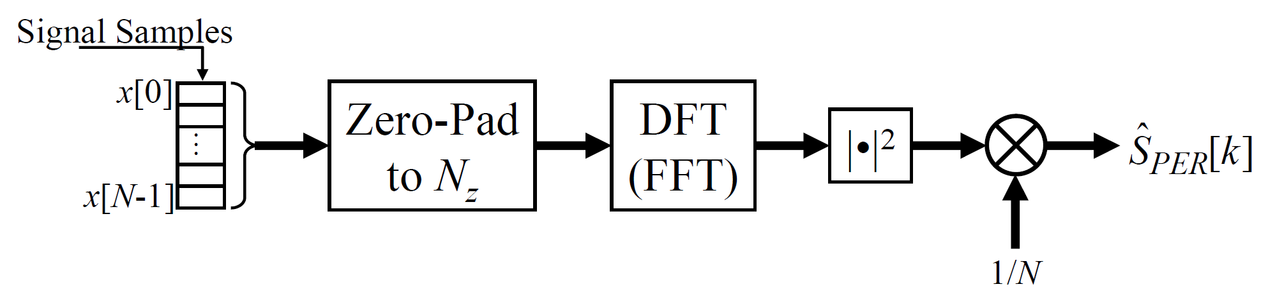
Periodogram (2)
Periodogram –Computation
In practice, we compute this using the DFT (FFT) (usually using zero-padding) –which computes the DTFT at discrete frequency points (DFT bins):

Slide 15
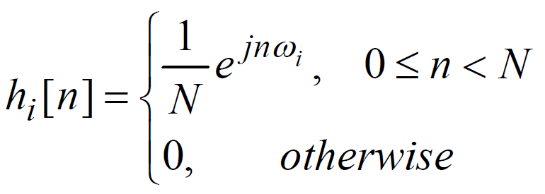
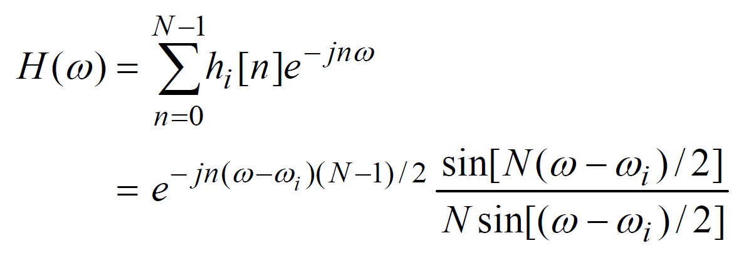
Periodogram (3)
Periodogram –viewed as Filter Bank
Although we always implement the periodogram using the DFT, it is helpful to interpret it as a filter bank.
Define the impulse response of an FIR filter as:
Frequency Response of this filter is:

Slide 16
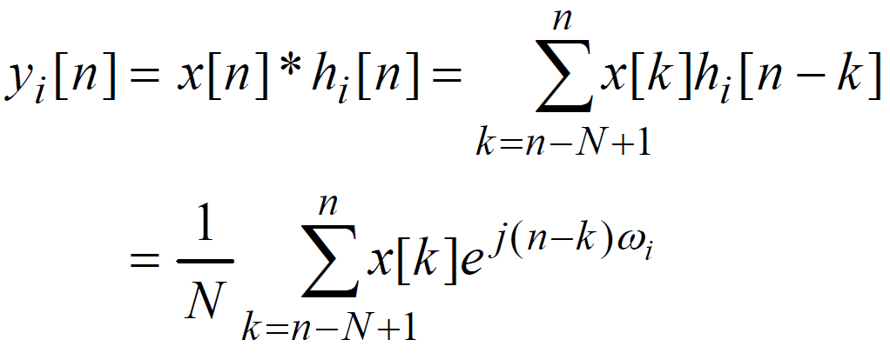
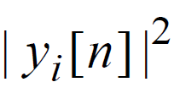
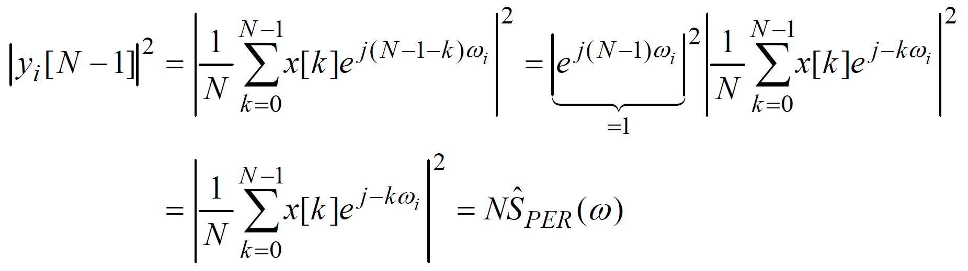
Periodogram (4)
Now the output of the i^{th} filter is:
Now one estimate of the power at the output of this filter is: for any value of n. Choosing n= N-1 gives the periodogram:

Slide 17
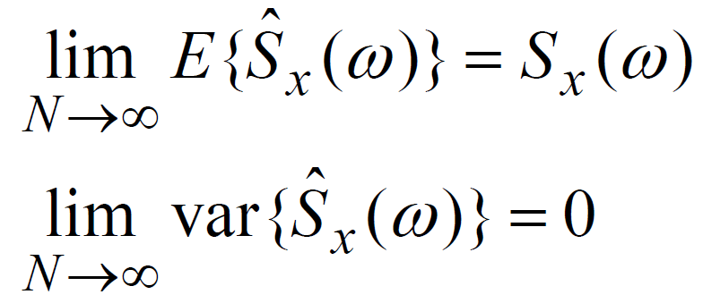
Periodogram (5)
Periodogram –Performance
For a good PSD estimate we’d like to have (at the very least):
Actually, we would prefer it to be unbiased even for finite N.
Does the periodogram have these characteristics?
: Asymptotic unbiased

Slide 18
Periodogram (6)
Property #1: The periodogram is biased.
Property #2: But, the periodogram is asymptotically unbiased.

Slide 19
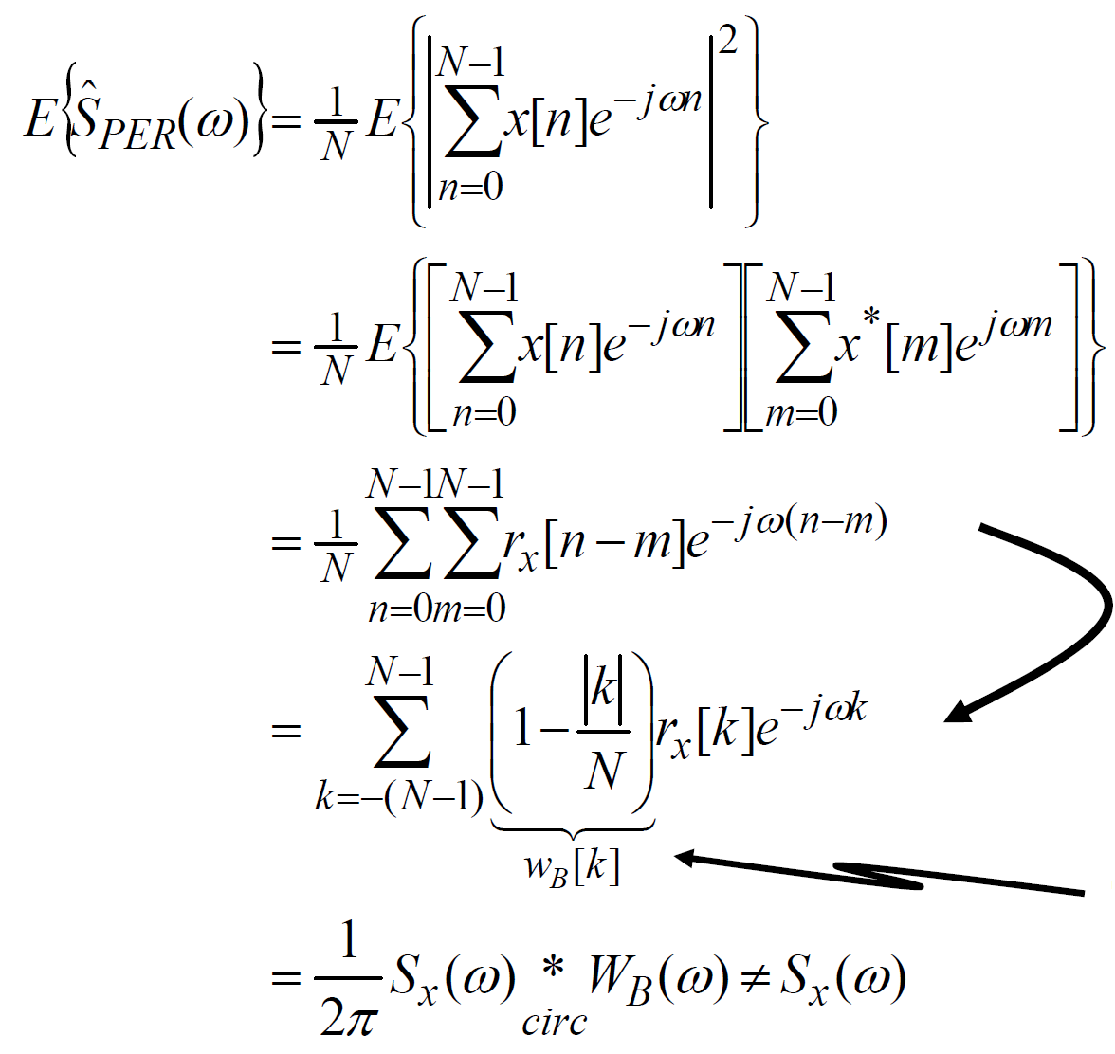
Periodogram (7)
Proof: Taking the expected value of the periodogram gives
Sum on diagonals
r_{x}[n-m] is constant on
each diagonal
Bartlett (Triangle)
window

Slide 20
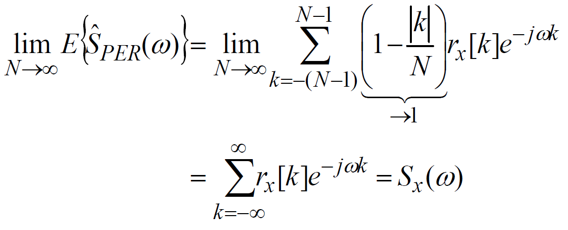
Periodogram (8)
This shows that the periodogram is biased. The bias comes from the smoothing effect of Bartlett window.
(Smoothing also reduces the resolution of sharp spectral features)
But, as N→∞, the Bartlett kernel tends to a delta function in the frequency domain, or –equivalently –in the time domain the Bartlett window tends 1:
Thus, the periodogram is asymptotically unbiased.

Slide 21
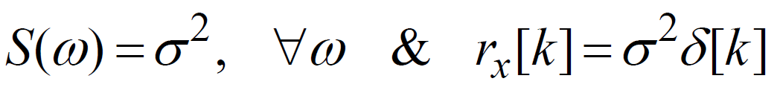
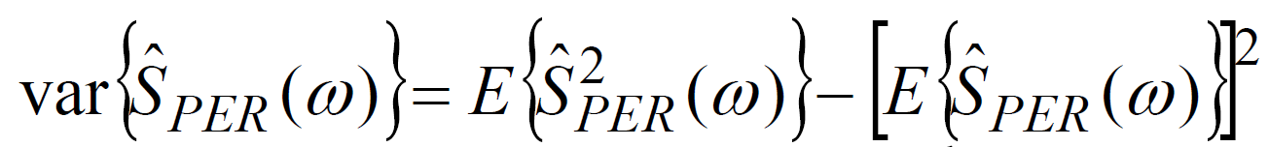
Periodogram (9)
Property #3: The variance of the periodogram does not (in general) tend to zero as N→∞.
Proof: Difficult to prove for general case, so this is proved under the assumption: complex-valued white Gaussian process with zero mean and variance σ².
Under this assumption, the true PSD and ACF are:
The variance of the periodogram is what we want to analyze and is given by:
Bias term

Slide 22
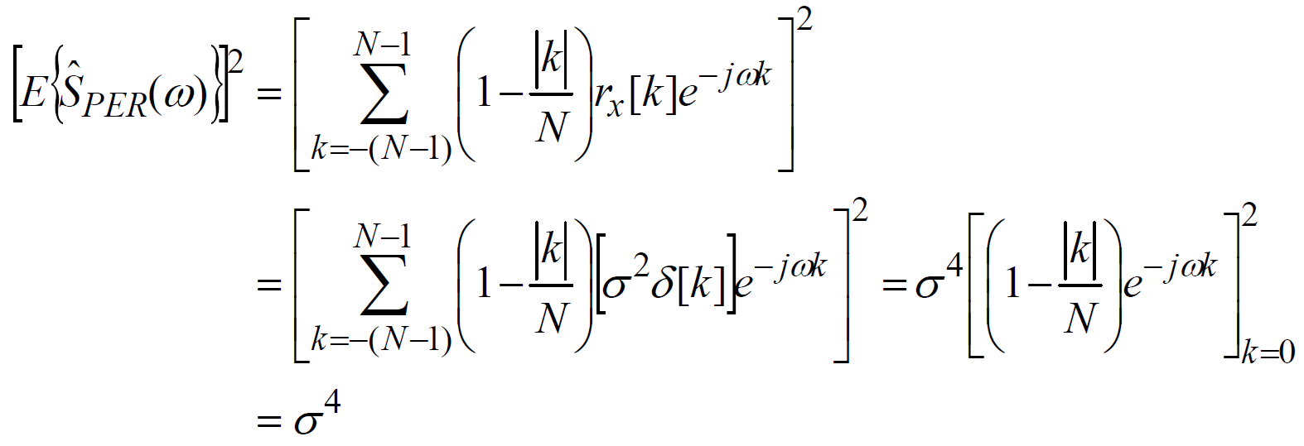
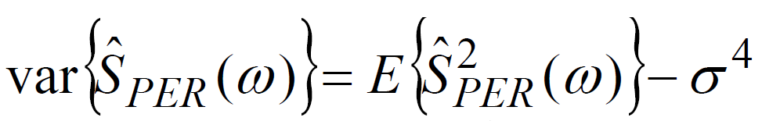
Periodogram (10)
So from our previous analysis of bias (and our assumptions on the process) we know that the second term is:
So the variance of periodogram is now:

Slide 23
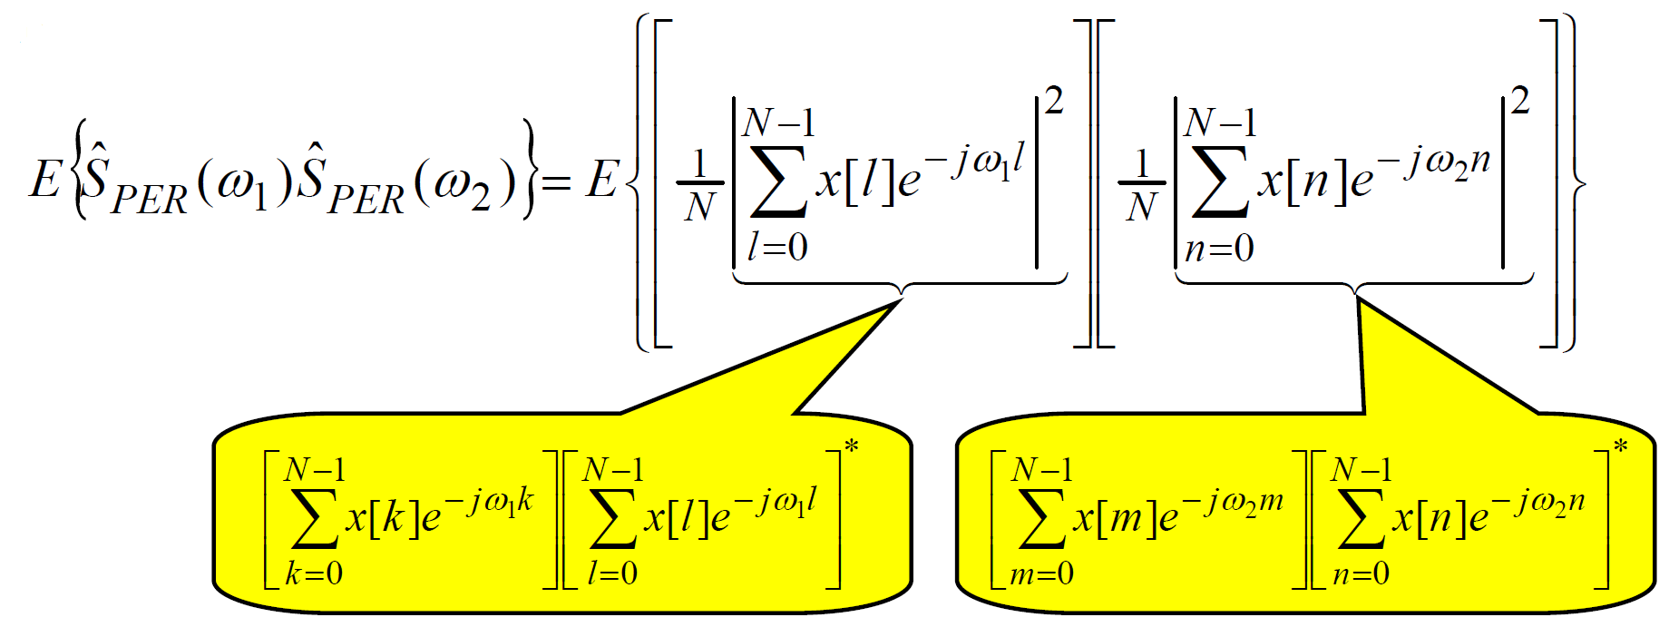
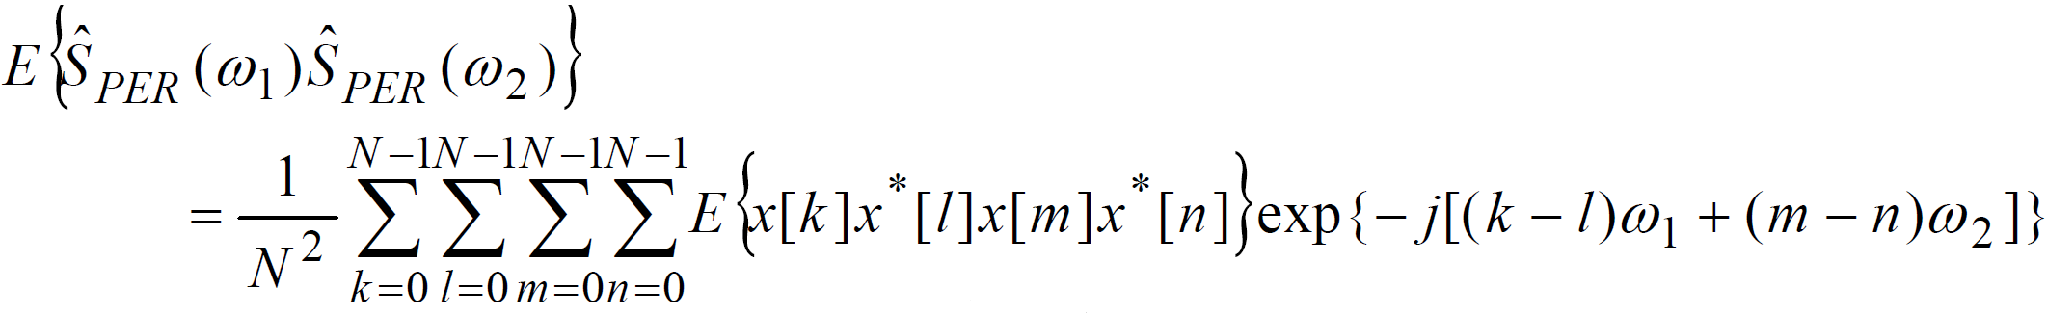
Periodogram (11)
As a means of looking at this first term we consider:

Slide 24
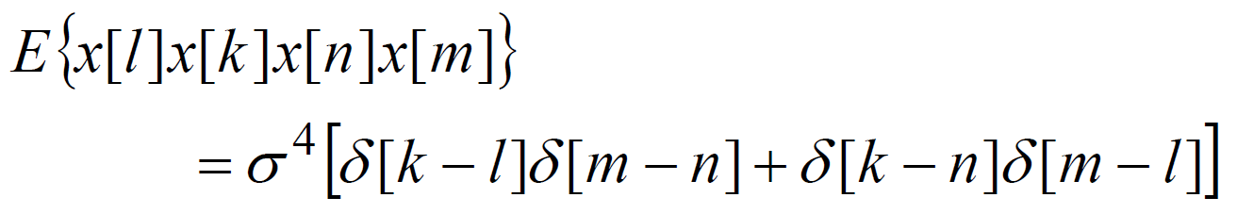
Periodogram (12)
Since we assumed the process is Gaussian we can use a standard result for complex joinly Gaussian RVs:
Using this result together with the assumption of whiteness:

Slide 25
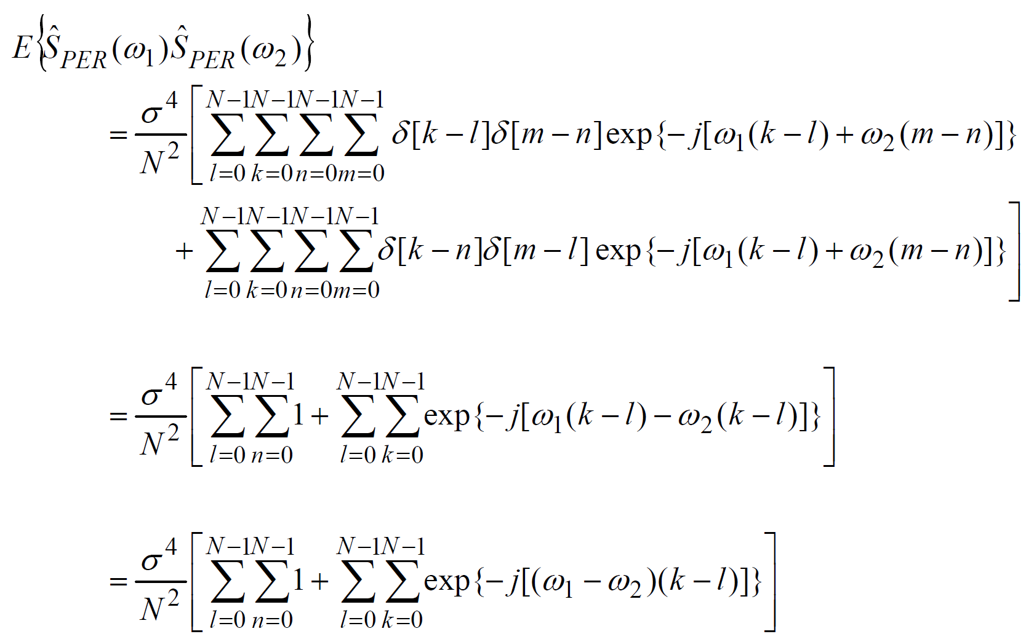
Periodogram (13)
Therefore,

Slide 26
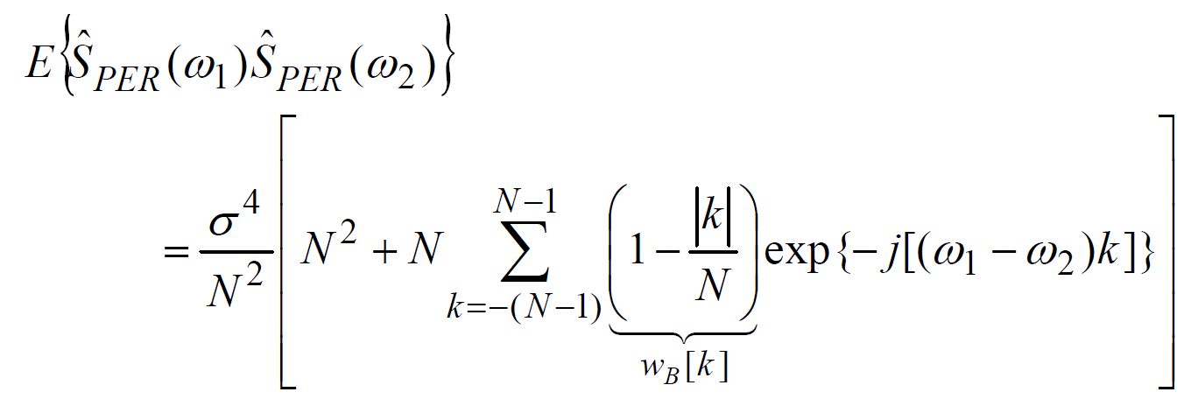
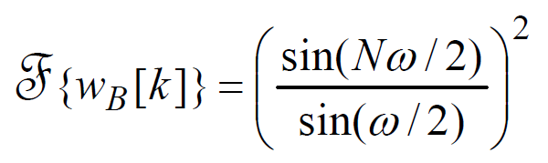
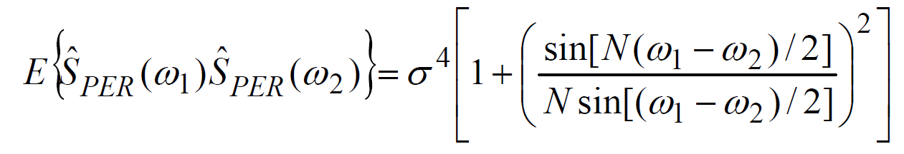
Periodogram (14)
Now the Fourier transform of the Bartlett window is:
So using it in the above result gives:

Slide 27
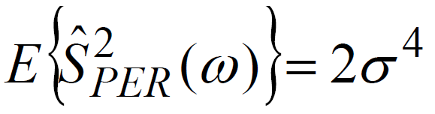
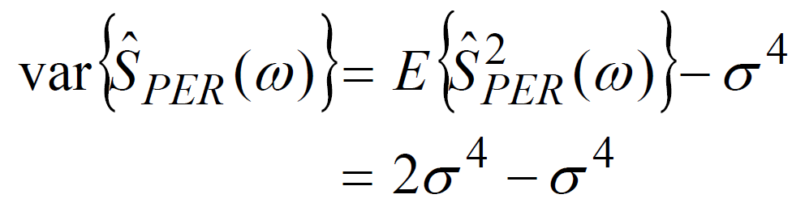
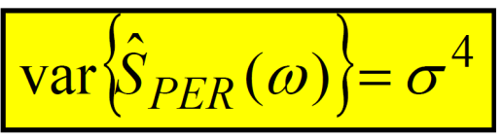
Periodogram (15)
To find the first term in the variance expression of interest, we must set ω = ω₁= ω₂ in the above expression to get:
Now using this in the expression for variance gives:
which does not go to zero as N→∞

Slide 28
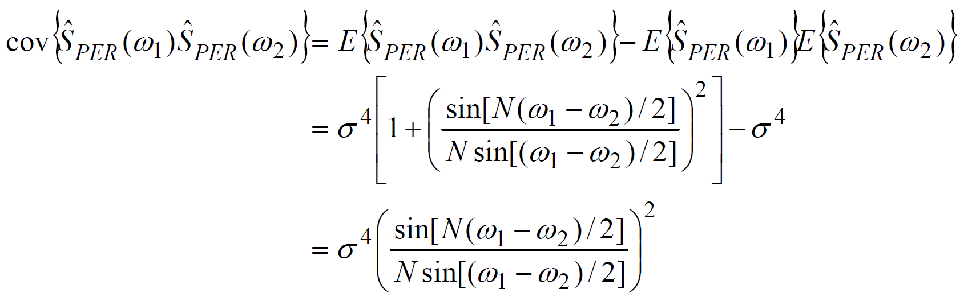
Periodogram (16)
Property #4: Increasing N leads to rapidly fluctuating periodograms (even where the true PSD is smooth).
Proof: Use the previous results, the covariance of the periodogram is given by
Covariance is a measure of how correlated two RVs are. Thus, cov(X,Y) = 0 indicates that there is a high probability that X & Y will be very unalike.

Slide 29
Periodogram (17)
Now, the equation above indicates there are (ω₁, ω₂) pairs for which the covariance of the periodogram is zero.
⇒ Periodogram fluctuates rapidly from frequency-to-frequency.

Slide 30
Practical Classical Methods (1)
Main problems of the periodogram
Biased estimate
Variance does not decrease with increasing N
Rapid fluctuations
All of these arise due to the fact that the periodogram ignores:
The expected value – (It includes no averaging)
The limit operation – (It applies a rectangular window)
in the PSD definition.
Several classical methods for partially fixing these have been proposed.

Slide 31
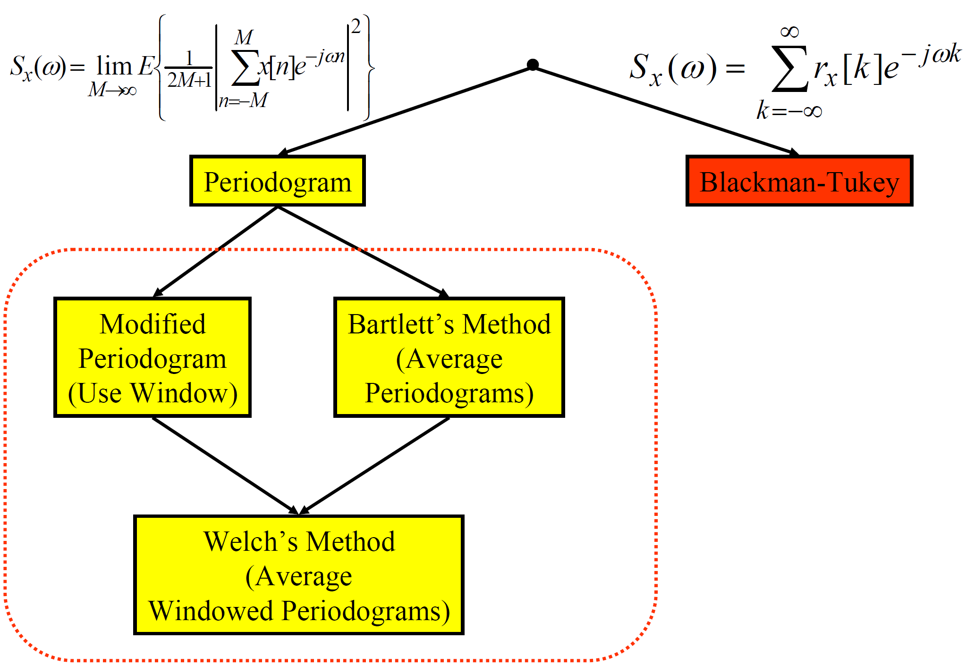
Practical Classical Methods (2)
Modifications based on periodogram view
Recall: Family of classical methods:

Slide 32
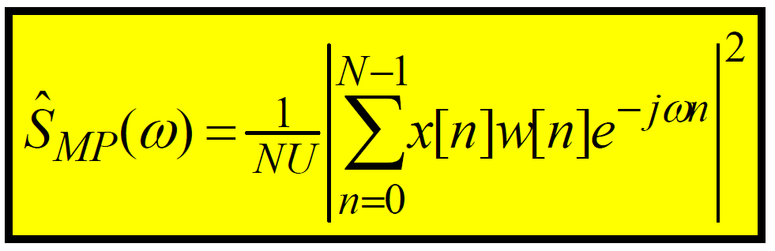
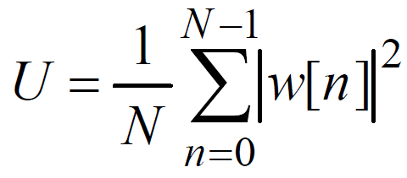
Practical Classical Methods (3)
Modified periodogram –windowed
The modified periodogram uses a non-rectangular window and therefore has to be scaled to account for the loss of power due to the window. This scaling is required to make the modified periodogram asymptotically unbiased:
where the scaling factor is
Note: U = 1 for a rectangular window.
As in the ordinary periodogram, the DFT/FFT is used for computation and zero-padding is usually used.

Slide 33
Practical Classical Methods (4)
The modified periodogram:
Has reduced bias but is still biased.
Is asymptotically unbiased.
Has variance that roughly equals that of the periodogram.

Slide 34
Practical Classical Methods (5)
Bartlett’s method: Averaged periodogram
One of the main flaws in the periodogram is the lack of averaging.
This lack of averaging is what leads to the non-decreasing variance as well as the rapid fluctuations of the periodogram.
Now, in practice we have only one realization.
We hope that the process is ergodic. A process is ergodic if time averaging of any realization is equivalent to ensemble averaging.

Slide 35
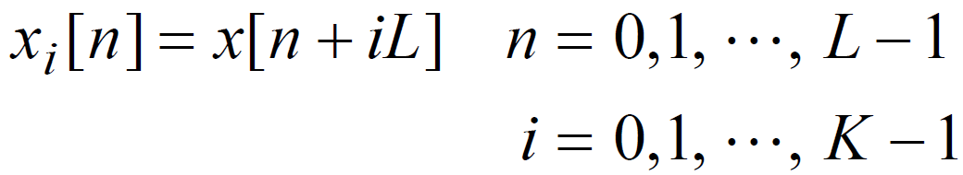
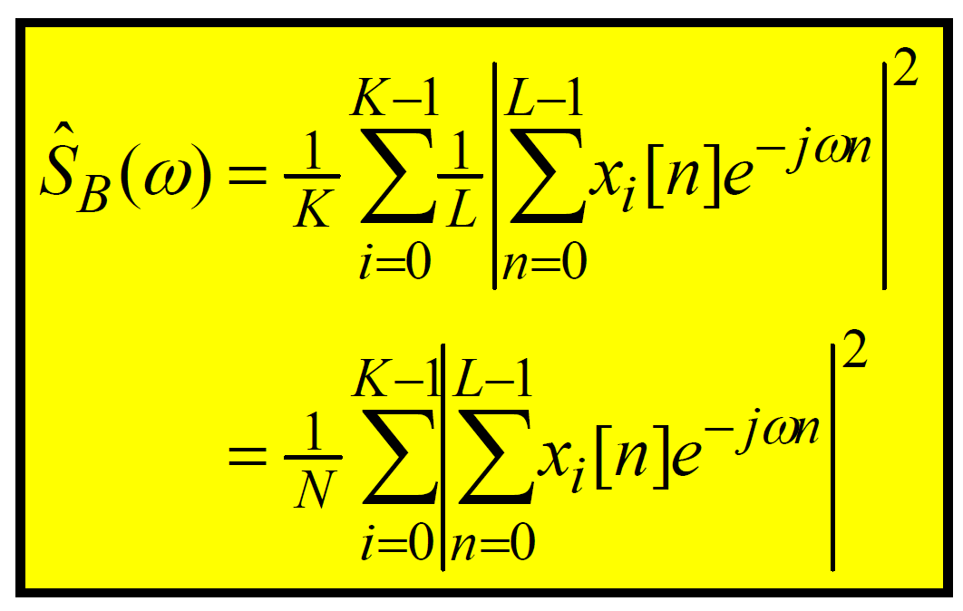
Practical Classical Methods (6)
Bartlett’s method –definition
The signal data of length N is chopped into K non-overlapping blocks of length L (the length L is a design choice); N = KL:
Block definition:

Slide 36
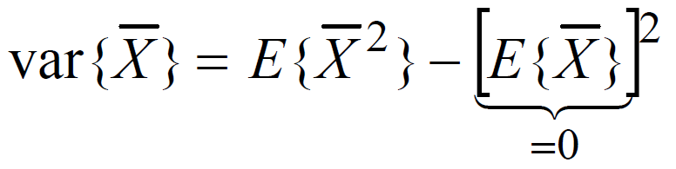
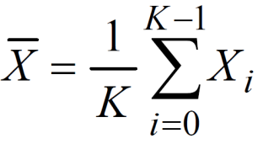
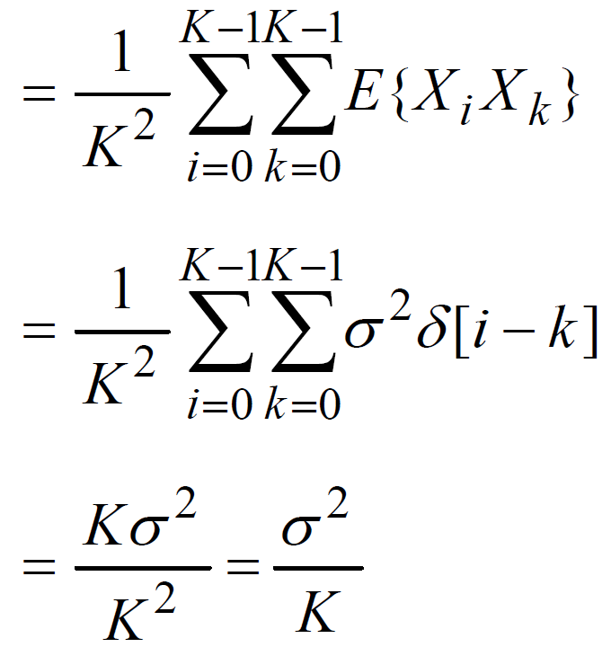
Practical Classical Methods (7)
Variance improvement
The intent of averaging here is to improve the variance. To see how lets first just look at a simple related example:
Let X_{i}, i= 0, 1, …, K-1 be a sequence of independent, identically distributed RVs each having zero-mean and variance σ². What is the variance of the data analysis average of them?

Slide 37
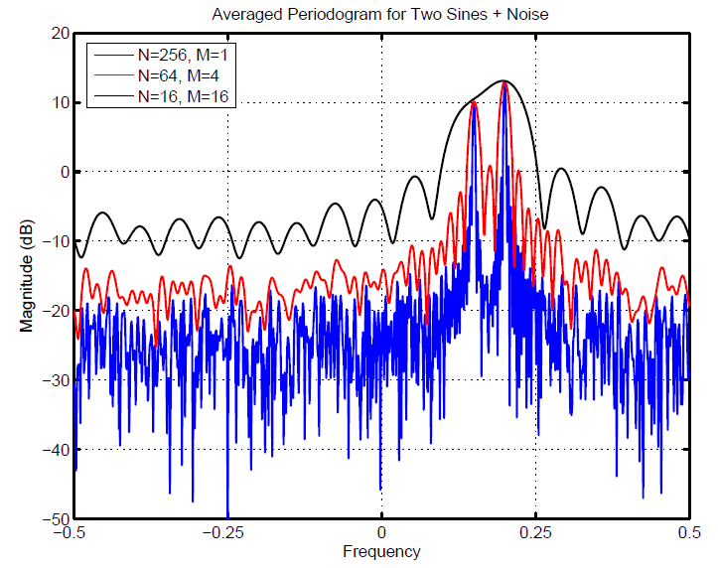
Practical Classical Methods (8)
Example: Averaged periodogram for two sines + noise

Slide 38
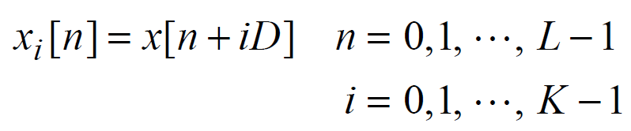

Practical Classical Methods (9)
Welch’s method: Averaged windowed periodogram
We’ve seen:
Windowing helps the bias
Averaging helps the variance
Welch: Do both and…. use overlapped blocks.
Block definition:
The amount of overlap is L–D points:
D= L: No overlap
D= L/2:50% overlap (most common)
D= 3L/4:25% overlap
Implement using
DFT/FFT and
zero-padding

Slide 39


Practical Classical Methods (10)
Variance has been shown to be for 50% overlap:
Compared to Bartlett’s method (no overlap) for the same N and L:
almost a 50% reduction.

Slide 40
Practical Classical Methods (11)
Windowing is useful for signals containing sinusoids + noise
Sidelobes of a stronger sinusoid may mask the main lobe of a
nearby weak sinusoid.
We multiply x[n] by window w[n] before computing periodogram
Weaker sinusoid becomes more visible, but main lobe of each sinusoid broadens: two close peaks may merge into one.

Slide 41

Practical Classical Methods (12)
Commonly used windows:

Slide 42

Practical Classical Methods (13)
Example: Three sine waves

Slide 43

Practical Classical Methods (14)

Slide 44

Practical Classical Methods (15)
Modifications based on ACF view: Blackman-Tukey method
Periodogram’s biggest problem is a variance that does not decrease with increasing N.
The methods we’ve seen dealt with this by averaging.
There is another way to combat this. To see how, we need to write the periodogram differently –motivated by the Wiener-Khinchine theorem:

Slide 45

Practical Classical Methods (16)
The periodogram can be written as:

Slide 46


Practical Classical Methods (17)
Thus, the periodogram can be written as:
i.e, as a DTFT of an estimated ACF given by
It is the poor quality of this ACF estimate that gives rise to the periodogram’s poor quality.

Slide 47

Practical Classical Methods (18)
Example of ACF estimation:

Slide 48

Practical Classical Methods (19)
Blackman-Tukey method –defined:
For the biased ACF estimate, the estimated ACF lags for large |k| values are unreliable.
De-emphasize these unreliable lags by applying a window to the biased ACF estimate. This is the Blackman-Tukey method:
with M < N – 1.
Since windows taper off to zero at their edges this causes the poor-quality estimates at large |k| values to have less impact on the PSD estimate.

Slide 49


Practical Classical Methods (20)
In practice we compute this using the DFT(FFT) (usually using zero-padding) –which computes the DTFT at discrete frequency points (DFT bins):
It is useful to explore a frequency domain interpretation of it. By using the multiplication-convolution theorem for DTFT we have:
The BT estimate is a smoothed version of the periodogram.
( Product in Time Domain) ⇔
(Convolution in Frequency Domain)

Slide 50

Practical Classical Methods (21)
BT performance: Bias:

Slide 51


Practical Classical Methods (22)
BT performance: Variance:

Slide 52



Practical Classical Methods (23)
Now, further approximation must be done do get a meaningful result. If N is large enough, the sin-over-sin kernel will be enough like a delta function (with area 2π/N) to treat it approximately as one:
Now, further approximation: assume that the true PSD is fairly constant over any interval of width = to mainlobe of W(ω):
Paserval theorem

Slide 53

Practical Classical Methods (24)
Recommended: M < N/5
Basic Tradeoff between Bias and Variance:
Need large M to get small bias
– In order to get narrow mainlobe and low sidelobes.
• Need M << N to get low variance
– In order to reduce the bracketed term in variance equation.

Slide 54

Practical Classical Methods (25)
Performance measures
Variability (small v is desirable):
Resolution: One of the important measures of goodness for spectral analysis is resolution –the ability to see two closely-spaced sinusoids.
The width of the mainlobe of the window’s kernel impacts this ability. There are many ways to measure resolution, one way is:
Small Δω is desirable. Two things impact mainlobe width:
1. Window length: Δω ↓ as Length ↑
2. Window shape (e.g. Hanning, Hamming, etc.)
There is a tradeoff between Δω and sidelobe level.

Slide 55

Practical Classical Methods (26)
Overall Figure of Merit
It is helpful to have a single measure by which to compare methods. This is done using the following Figure of Merit:
Since v and Δω are both required to be as small as possible, we also want the figure of merit to be as small as possible.

Slide 56

Practical Classical Methods (27)
Performance comparison of classical methods

Slide 57
Practical Classical Methods (28)
Complexity comparison of classical methods
Welch and BT methods are the most commonly used ones. But counting the number of complex multiplies needed for each one, it is easy to see that: Welch requires a bit more computation then BT.
But, for BT, none of the ACF lags can be estimated until ALL of the data is obtained –therefore no computing can be done until all the data is obtained. For Welch, DFT’s can be started as soon as each block arrives.
Welch might have a real-time advantage.

Slide 58

Minimum Variance Method (MVSE) (1)
Family of Non-Parametric Methods

Slide 59
Minimum Variance Method (2)
The Minimum Variance Spectral Estimation (MVSE) method has two other names:
Maximum Likelihood Method (MLM)
Capon’s Method
Note: The names MVSE and MLM are actually misnomers –this method:
does NOT minimize the variance of the estimate
does NOT maximize the “likelihood function”

Slide 60

Minimum Variance Method (3)
Recall: Filter bank view of periodogram
The problem is leakage from nearby frequencies:

Slide 61

Minimum Variance Method (4)
Goal for MVSE Method
Figure out a way to design each filter bank channel response to minimize the leakage –this is thus a data-dependent design.
Collect Data ⇒ Design filters for filter bank
Want to design filters to minimize the sidelobes while keeping the mainlobe height at 1:
Design goals:
1. Want H_{i}(ω_{i}) = 1 to let through the desired S_{x}(ω_{i})
2. Minimize total output power in the filter:
This is equivalent to minimizing the sidelobe contribution even though the integral includes the desired ω_{i}

Slide 62


Minimum Variance Method (5)
Useable form for ρ
The frequency response of filter h_{i}[n] is:
Using this in the expression for ρ gives:
p = Filter length, p < N
Recognize as vector-matrix-vector multiplication, R_{x}: correlation matrix

Slide 63




Minimum Variance Method (6)
For each i, minimize this:
Under this constraint:
where
Most common way to do constrained optimization is using the Lagrange Multiplier method:
Find h_{i} and λ to minimize J, in general set:
But often an easier way is to do these two steps:
1. Do the partial w.r.t. h_{i} and solve for h_{i}
2.Then choose λ to ensure solution meets the constraint

Slide 64


Minimum Variance Method (7)
Gradient:
If g(x) is a scalar-valued function of a real-valued vector x, then the gradient of g(x) is defined as:
Gradient here is nothing more than: the vector whose elements are the partials w.r.t. each element of x.
(Note: There are similar definitions when g(x) is vector-valued.)
Example:

Slide 65




Minimum Variance Method (8)
Step 1: For our scalar-valued function J, we get:
Solve this for h_{i,o}:
Step 2: Choose λ to make this solution satisfy constraint:
Now use this λ in optimal h_{i,o}:
This gives the optimal filter for estimating the power at the frequency ω_{i}

Slide 66


Minimum Variance Method (9)
In principle–we need to solve h_{i,o} for each frequency ω_{i} at which we wish to get a PSD estimate. Then we would compute the output power at each filter and that would be our PSD estimate (based on an equation for the output power: ρ_{i})
The estimate of the power at ω_{i} is nothing more than the minimized value of ρ_{i}:
Thus, the estimated power at frequency ω_{i} is:

Slide 67

Minimum Variance Method (10)
To get the power spectral density (PSD) we need to divide by the filter’s bandwidth –for a filter of length p the bandwidth is approximately 1/p so our MVSE PSD estimate is:
This estimate requires the ACF in matrix form. So, we need an estimate of the ACF in matrix form.

Slide 68


Minimum Variance Method (11)
Estimating ACF in matrix form:
where

Slide 69
Minimum Variance Method (12)
MVSE –Comments:
Implementation of MVSE:
Generally done directly on the data matrix X for efficiency.
Even with that, it is more complex than classical methods.
Performance of MVSE:
Provides better resolution than classical methods.
Mostly used when spiky spectra are expected
(Although, the AR methods are usually better in that case)
If required resolution can be met with classical methods, then use them. If not –consider either MVSE or Parametric methods.

Slide 70
Parametric Spectral Estimation

Slide 71
Parametric Spectral Estimation (1)
Time series models = Parametric models
Time series = Discrete-time random signal

Slide 72


Parametric Spectral Estimation (2)
Motivation for time series models
If the input ε[n] is white with power σ² then:
Then the shape of output PSD is completely set by H(ω).
Thus, under this model, knowing the LTI system’s transfer function (or frequency response) tells everything about the PSD.

Slide 73

Parametric Spectral Estimation (3)
The transfer function of an LTI system is completely determined by a set of parameters {b_{k}} and {a_{k}}:
If we can assure that the random processes can be modeled as the output of a LTI system driven by white noise, then
Estimating Parameters = Estimating PSD

Slide 74



Parametric Spectral Estimation (4)
Parametric PSD models
The most general parametric PSD model is then:
Model parameters:
The output of the LTI system gives a time-domain model for the process:

Slide 75
Parametric Spectral Estimation (5)
There are three special cases that are considered for these models:
Autoregressive (AR)
Moving Average (MA)
Autoregressive Moving Average (ARMA)

Slide 76


Parametric Spectral Estimation (6)
Autoregressive (AR) PSD models
If the LTI system’s model is constrained to have only poles, then:
Order of the model is p: called AR(p) model
Poles give rise to PSD spikes.
Output depends
regressively on itself

Slide 77


Parametric Spectral Estimation (7)
Moving Average (MA) PSD models
If the LTI system’s model is constrained to have only zeros, then:
Order of the model is q: called MA(q) model.
Zeros give rise to PSD nulls.
Output is an average of values inside a moving window

Slide 78


Parametric Spectral Estimation (8)
Autoregressive Moving Average (ARMA)
If the LTI system’s model is allowed to have Poles & Zeros, then:
Order of the model is p,q : called ARMA(p,q) model
Poles & Zeros give rise to PSD spikes and nulls.

Slide 79


Parametric Spectral Estimation (9)
ACF model of a process
So far we’ve seen relationships between:
PSD model
Time-domain model
These models impart a corresponding model to the ACF:
Let the process obey an ARMA(p,q) model:
To get ACF: multiply both sides of this by x[n-k] and take E{}:

Slide 80


Parametric Spectral Estimation (10)
To evaluate this –write x[n] as output of filter with input ε[n]:
We have assumed a causal filter for a model:

Slide 81

Parametric Spectral Estimation (11)
Using this result gives the Yule-Walker equations for ARMA:
These equations are the key to estimating the model parameters.
We now look at simplifications of these for the AR and MA cases.
(ARMA)

Slide 82


Parametric Spectral Estimation (12)
ACF model for an AR process
Specializing to the AR case, we set q= 0 and get:
Now, we see that
Initial value theorem
for Z-Transform

Slide 83

Parametric Spectral Estimation (13)
Yule-Walker equations (AR):
If we look at k = 0, 1, …p for these AR Yule-Walker equations, we get p+1 simultaneous equations that can be solved for the p+1 model parameters of {a_{i}}_{i=1,…,p} and σ²:
(AR)

Slide 84

Parametric Spectral Estimation (14)
If we know the p×p autocorrelation matrix, then we can solve these equations for the model parameters.
Yule-Walker Equations (AR)

Slide 85



Parametric Spectral Estimation (15)
ACF model for an MA process
Specializing to the MA case, we set p = 0 and get:
But, for the MA case the system is a FIR filter and we have
Yule-Walker equations (MA):
(MA)

Slide 86
Parametric Spectral Estimation (16)
Parametric PSD estimation
As mentioned above, the idea here is to find a good estimate of the model parameters and then use those to get an estimate of the PSD. The basic idea holds regardless if it is ARMA, AR, or MA. We consider only the AR case.
Here is the general AR method: Given data {x[n], 0 ≤ n ≤ N-1}
Estimate the p×p autocorrelation matrix from the data:
Solve the AR Yule-Walker equations for the AR model:

Slide 87


Parametric Spectral Estimation (17)
3. Compute the PSD estimate from the model

Slide 88


Parametric Spectral Estimation (18)
Two common methods (but there are many others):
Autocorrelation method
Estimate the ACF using:
Covariance method
Estimate using:

Slide 89

Parametric Spectral Estimation (19)
Solve using

Slide 90

Parametric Spectral Estimation (20)
Least Squares method & linear prediction
There is another method that is often used that comes at the problem from a little different direction.
Recall: The above idea was based on the Yule-Walker equations, which are in terms of the ACF (which is unknown in practice). Thus we need to estimate the ACF to use this view.
Least Squares provides a different way to estimate the AR parameters.
Recall: The output of an AR model is given by

Slide 91


Parametric Spectral Estimation (21)
If we re-arrange this output equation we get:
There are lots of applications where linear prediction is used: Data compression, target tracking, noise cancellation etc.
Goal: Find a set of prediction coefficients {a_{k}} such that the sum of squares (least squares) of the prediction error is minimized.

Slide 92



Parametric Spectral Estimation (22)
To choose the {a_{k}} to minimize V we differentiate and set = 0
Now we use:

Slide 93




Parametric Spectral Estimation (23)
So to solve the LS linear prediction problem we need:
Define:
1. Matrix Γ with elements λ_{lk}
2. Vector λ with elements λ_{l0}
3. Vector a with elements a₁,…, a_{p}
where
Then (*) can be written as (exploiting that a₀= 1):
or
(*)

